Slide 1
Wheeled Locomotion
RBE500-F17-191
Lecture 07-2
Adj. Prof. Julian Center

Slide 2
Locomotion of Wheeled Robots
Locomotion (Oxford Dict.):
Power of motion from place to place
Differential drive
Car drive (Ackerman steering)
Synchronous drive
Mecanum wheels
skid

Slide 3



Instantaneous Center of Curvature
$$r_{1}$$
ICC
$$r_{2}$$
$$r_{3}$$
For rolling motion to occur without skidding, each wheel has to move only along its y-axis. Any x-axis motion is skidding. They all must move in a (generally) different radius about the Instantaneous Center of Curvature (ICC).

Slide 4
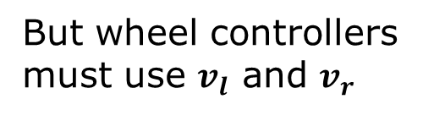
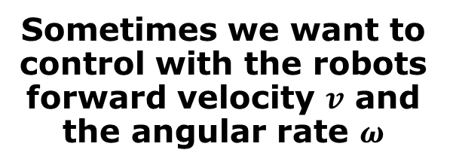
Differential Drive
Sometimes we want to control with the robots forward velocity $v$ and the angular rate $ω$
y
ω
ICC
v
l
But wheel controllers must use $v_{l}$ and $v_{r}$
R
θ
(x,y)
x
v
r
l/2

Slide 5
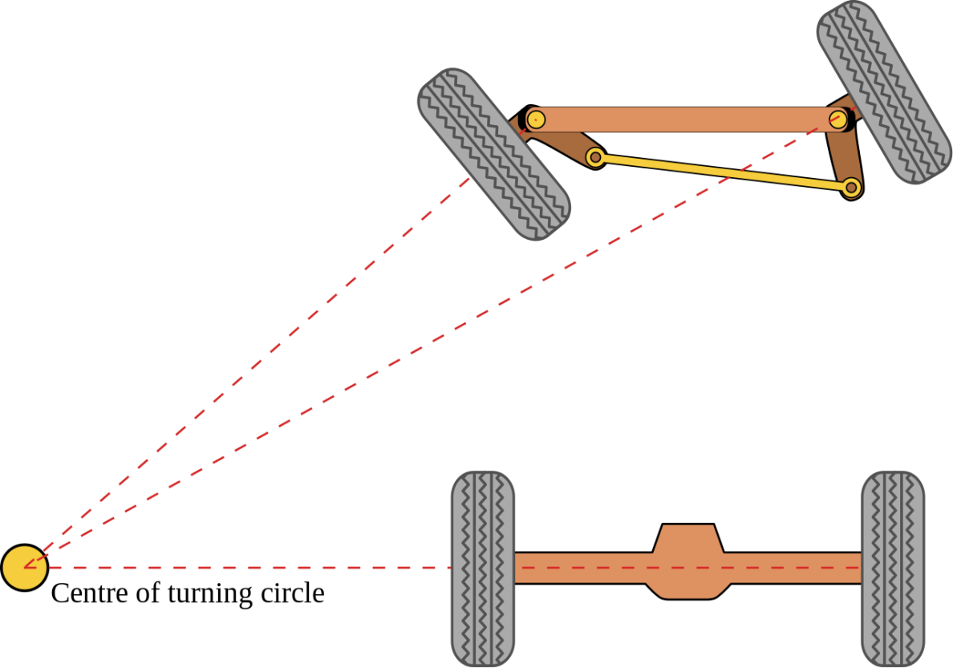
Ackermann Steering
Your car has Ackermann steering so that the tires don’t skid on turns.
ICC
You also have a “differential” so that the outer tire can go faster then the inner tire because it must trace a larger circle.

Slide 6
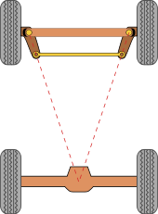
Simple Approximation for Designing Ackermann Steering
Invented by the German carriage builder Georg Lankensperger in Munich in 1817, then patented by his agent in England, Rudolph Ackermann (1764–1834) in 1818 for horse-drawn carriages.
Source: Wikipedia
Simple approximation for designing Ackermann linkage.

Slide 7



Synchonous Drive
y
$$\dot{x}\left(t\right)=v\left(t\right)cos\left[θ\left(t\right)\right]$$
$$\dot{y}\left(t\right)=v\left(t\right)sin\left[θ\left(t\right)\right]$$
v(t)
$$\dot{θ}=ω\left(t\right)$$
θ
x
ω( )
t

Slide 8
Synchronous Drive Equations of Motion
y
v_{i}(t)
ω_{i}(t)
θ
x
ICC

Slide 9





Holonomic Drive with Mecanum Wheels
How to go sideways
Y
$$v_{0}$$
$$v_{2}$$
$v_{x}=\left(v_{0}{−v}_{1}{+v}_{2}{−v}_{3}\right)$/4
X
$$v_{1}$$
$$v_{3}$$
Otherwise, drive is like tank drive.

Slide 10
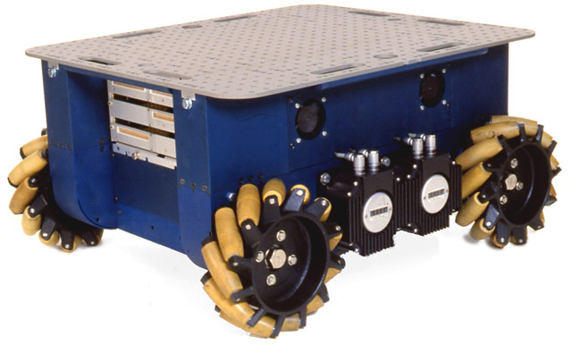
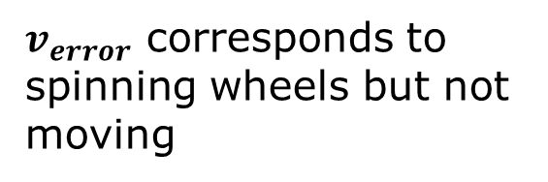
Dynamics of Mecanum Wheels
$v_{error}$ corresponds to spinning wheels but not moving
See Phidgets Holographic robot
https://www.youtube.com/watch?v=jxaSe6RJQvY

Slide 11
Non-Holonomic Constraints
Non-holonomic constraints limit the possible incremental movements within the configuration space of the robot.
Robots with differential drive or synchro-drive move on a circular trajectory and cannot move sideways.
Holonomic robots, like those with Mecanum wheels, can move sideways.

Slide 12
Holonomic vs. Non-Holonomic
Non-holonomic constraints reduce the control space with respect to the current configuration (e.g., moving sideways is impossible).
Holonomic constraints reduce the configuration space.
See Three Holonomic Robots
https://www.youtube.com/watch?v=_tmiu1wpp_E

Slide 13
Calculating Planar Motion from Odometry Data

Slide 14
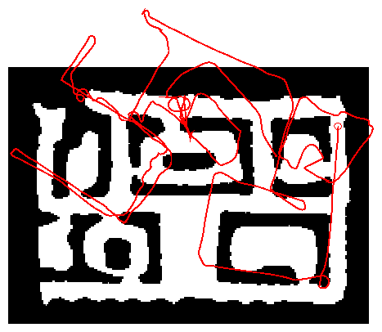
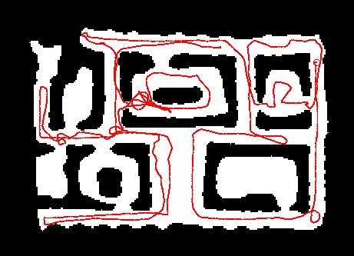
Robot Motion
Robot motion is inherently uncertain.
How can we model this uncertainty?

Slide 15
Probabilistic Motion Models
To implement the Bayes Filter, we need the transition model p(x| x’, u).
The term p(x| x’, u) specifies a posterior probability, that action u carries the robot from x’ to x.
In this section we will specify, how p(x| x’, u) can be modeled based on the motion equations.

Slide 16
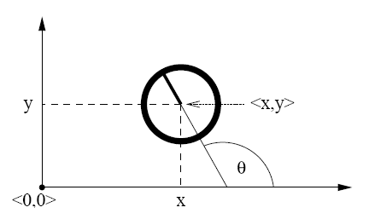
Coordinate Systems
In general the configuration of a robot can be described by six parameters.
Three-dimensional cartesian coordinates plus three Euler angles pitch, roll, and tilt.
Throughout this section, we consider robots operating on a planar surface.
The state space of such systems is three-dimensional (x,y,θ).

Slide 17
Typical Motion Models
In practice, one often finds two types of motion models:
Odometry-based
Velocity-based (dead reckoning)
Odometry-based models are used when systems are equipped with wheel encoders.
Velocity-based models have to be applied when no wheel encoders are given.
They calculate the new pose based on the velocities and the time elapsed.

Slide 18
Dead Reckoning
Derived from “deduced reckoning.”
Mathematical procedure for determining the present location of a vehicle.
Achieved by calculating the current pose of the vehicle based on its velocities and the time elapsed.

Slide 19
Reasons for Motion Errors
different wheel diameters
ideal case
bump
carpet
and many more …

Slide 20
Odometry Model
Robot moves from to .
Odometry information .

Slide 21
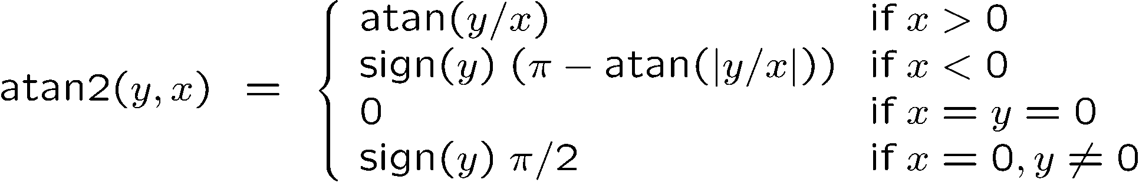
The atan2 Function
Extends the inverse tangent and correctly copes with the signs of x and y.

Slide 22
Noise Model for Odometry
The measured motion is given by the true motion corrupted with noise.

Slide 23
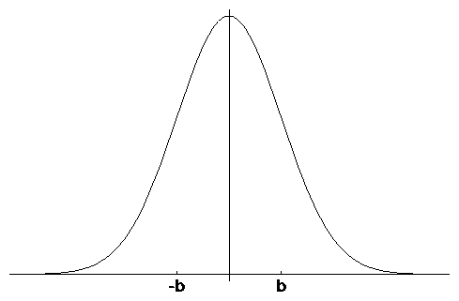
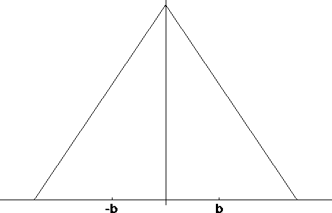
Typical Distributions for Probabilistic Motion Models
Normal distribution
Triangular distribution

Slide 24
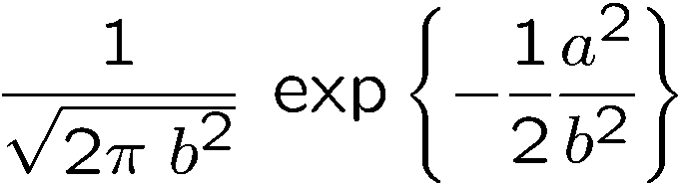
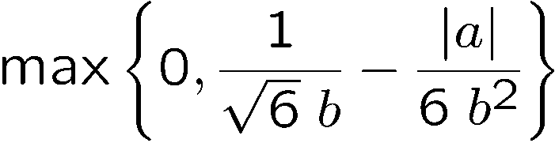
Calculating the Error Probability (zero-centered)
For a normal distribution
For a triangular distribution
Algorithm prob_normal_distribution(a,b):
return
Algorithm prob_triangular_distribution(a,b):
return

Slide 25
Calculating the Posterior Given x, x’, and u
Algorithm motion_model_odometry(x,x’,u)
return p₁ · p₂ · p₃
odometry values (u)
values of interest (x,x’)

Slide 26
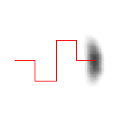

Application
Repeated application of the sensor model for short movements.
Typical banana-shaped distributions obtained for 2d-projection of 3d posterior.
p(x|u,x’)
x’
x’
u
u

Slide 27
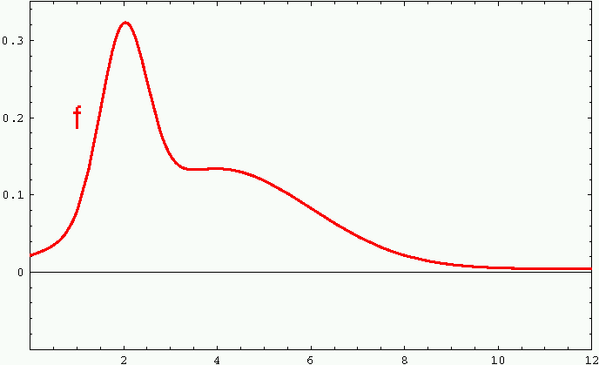
Sample-based Density Representation

Slide 28
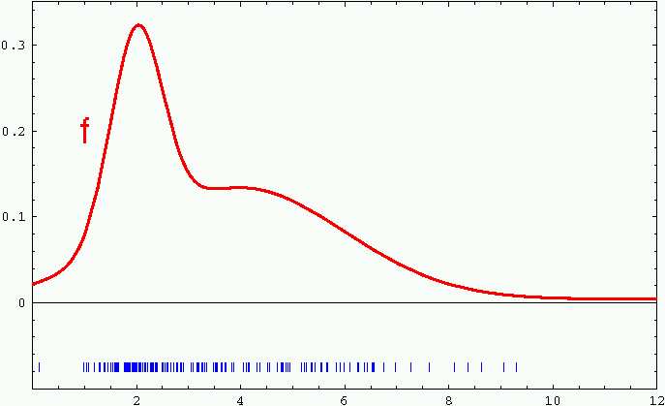
Sample-based Density Representation

Slide 29
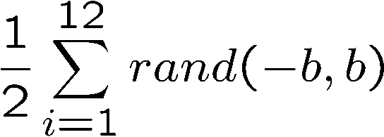
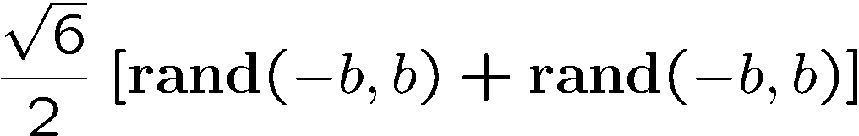
How to Sample from Normal or Triangular Distributions?
Sampling from a normal distribution
Sampling from a triangular distribution
Algorithm sample_normal_distribution(b):
return
Algorithm sample_triangular_distribution(b):
return

Slide 30
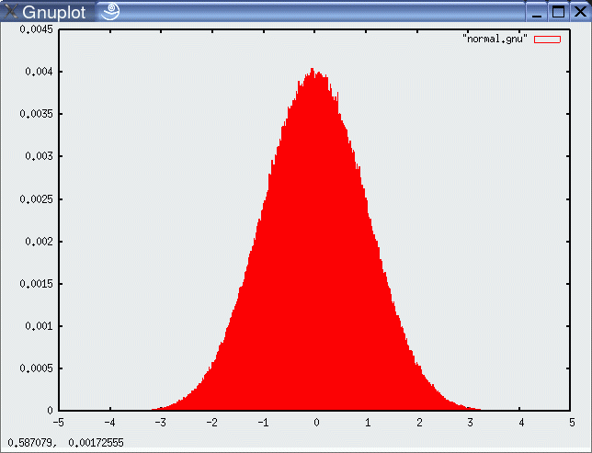
Normally Distributed Samples
10⁶ samples

Slide 31
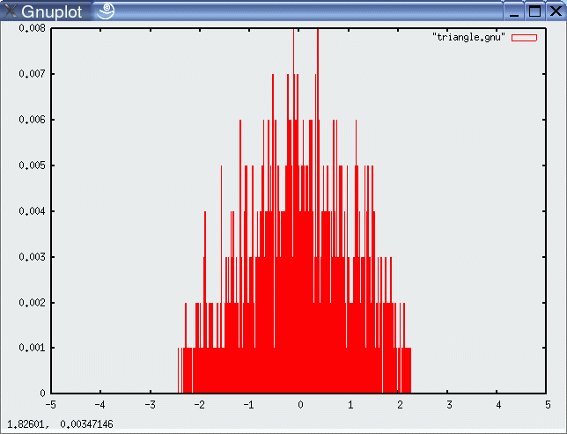
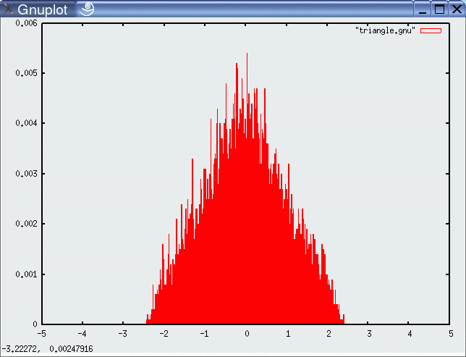
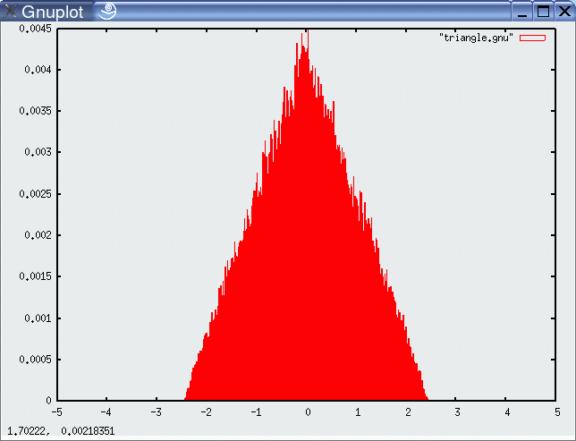
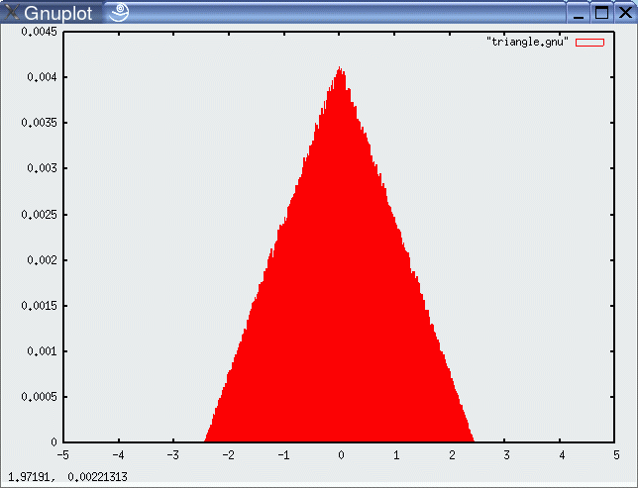
For Triangular Distribution
10³ samples
10⁴ samples
10⁵ samples
10⁶ samples

Slide 32
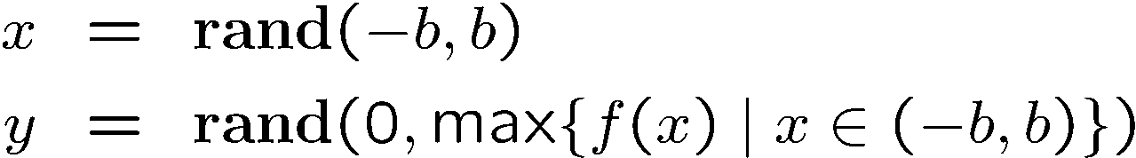


Rejection Sampling
Sampling from arbitrary distributions
Algorithm sample_distribution(f,b):
repeat
until ( )
return
Can be very inefficient!!!

Slide 33
Sample Odometry Motion Model
Algorithm sample_motion_model(u, x):
Return
sample_normal_distribution

Slide 34
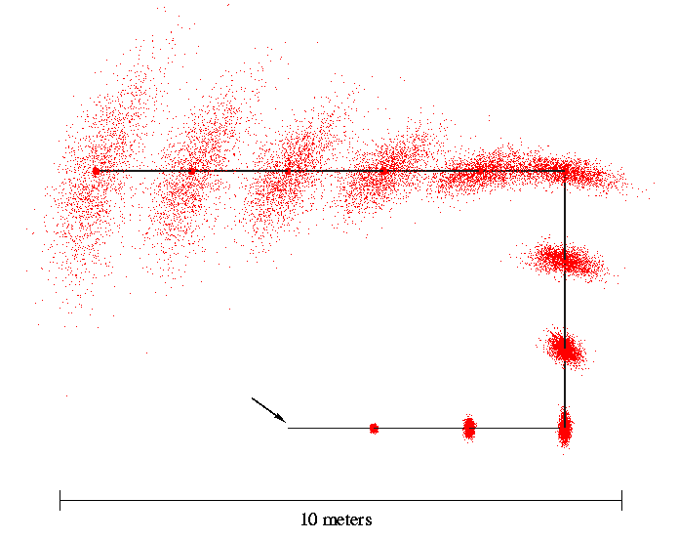
Sampling from Our Motion Model
Start

Slide 35
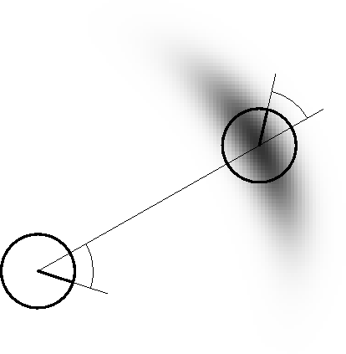
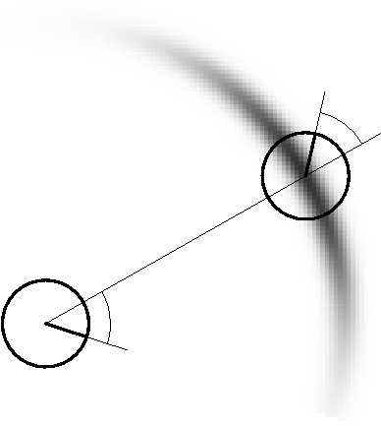
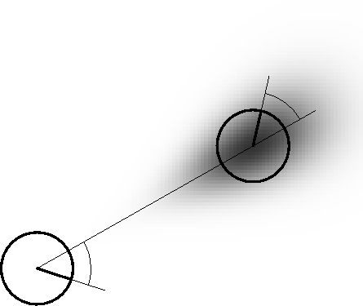
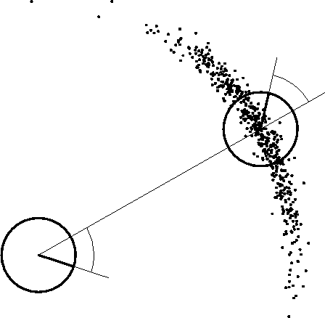
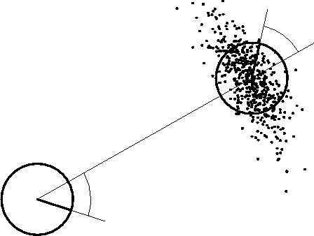
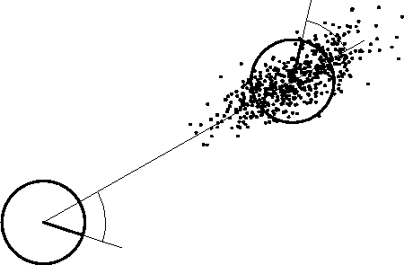
Examples (Odometry-Based)

Slide 36
Velocity-Based Model

Slide 37
Equation for the Velocity Model
Center of circle:
with

Slide 38
Posterior Probability for Velocity Model

Slide 39
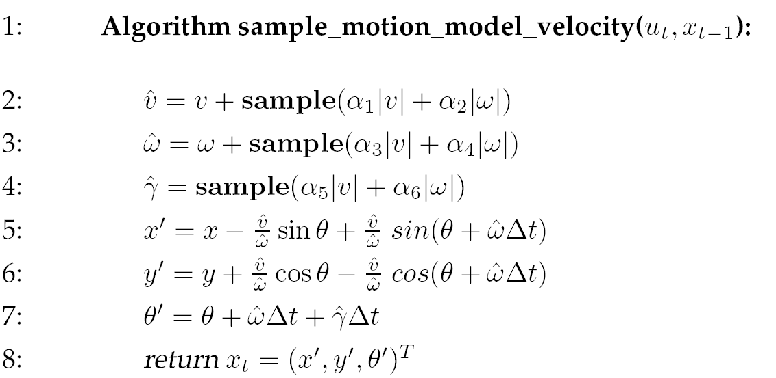
Sampling from Velocity Model

Slide 40
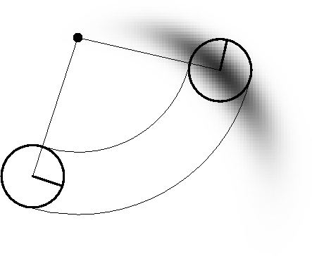
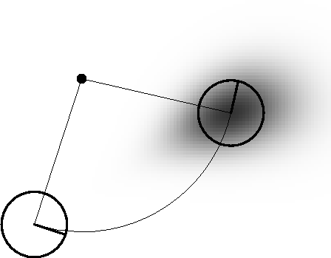
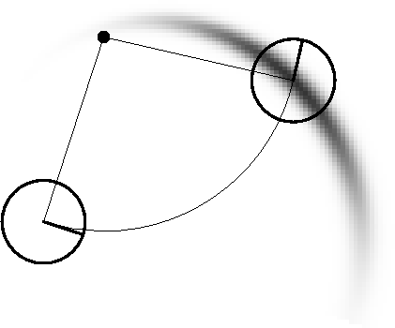
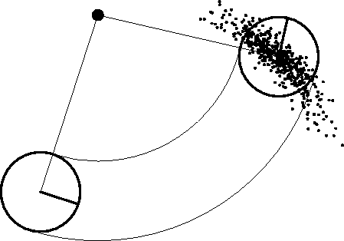
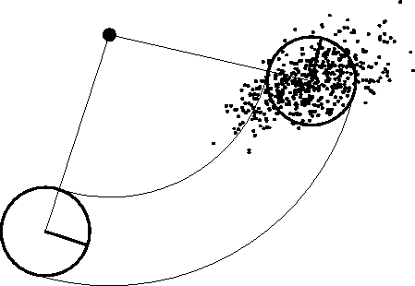
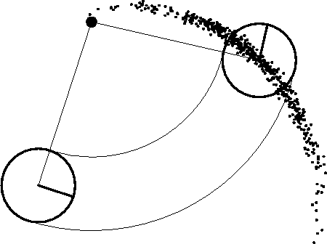
Examples (velocity based)

Slide 41
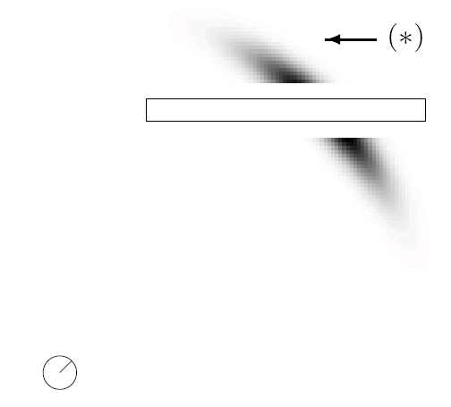
Map-Consistent Motion Model
≠
Approximation:

Slide 42
Summary
We discussed motion models for odometry-based and velocity-based systems
We discussed ways to calculate the posterior probability p(x| x’, u).
We also described how to sample from p(x| x’, u).
Typically the calculations are done in fixed time intervals Δt.
In practice, the parameters of the models have to be learned.
We also discussed an extended motion model that takes the map into account.

